Slide 1
FINANCIAL ANALYTICS

Slide 2
INTRODUCTION
Financial analysis is the process of evaluating businesses, projects, budgets, and other finance-related transactions to determine their performance and suitability. Typically, financial analysis is used to analyze whether an entity is stable, solvent, liquid, or profitable enough to warrant a monetary investment.

Slide 3
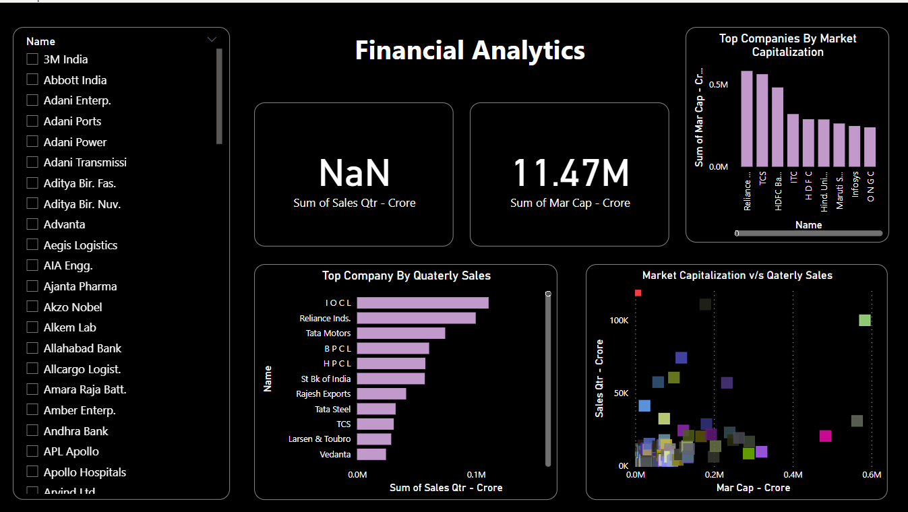

Slide 4
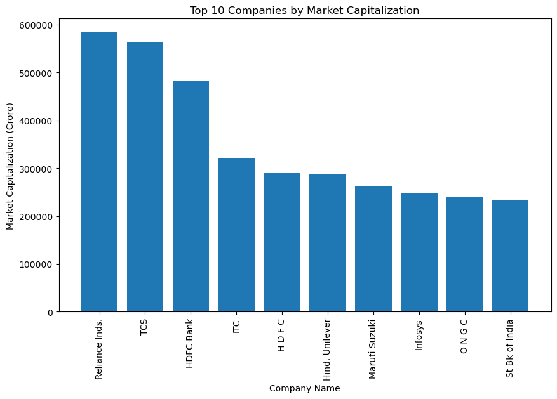
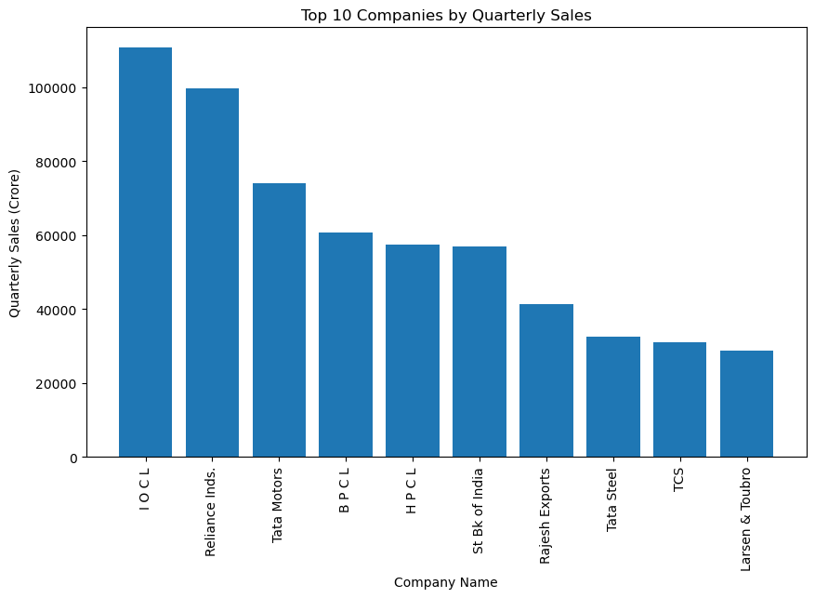

Slide 6
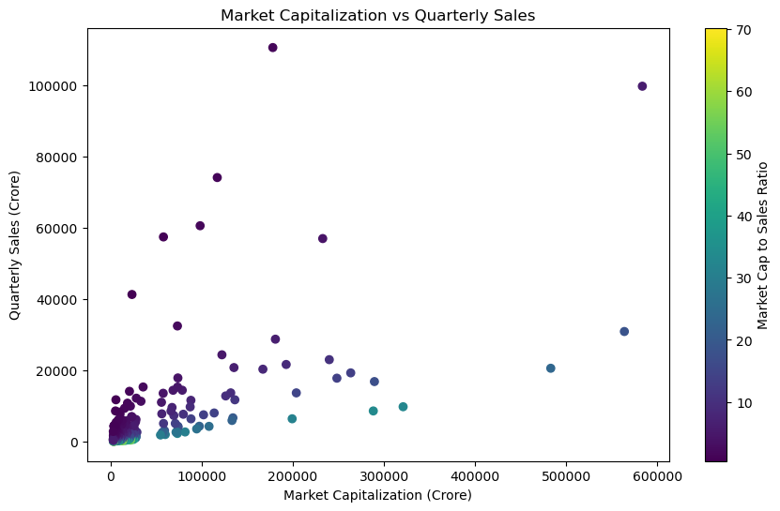

Slide 7
THANKYOU

